Slide 1
Internal presenter notes: What attendees should take away
Formatting Reminders:
15-20 slides maximum
Font: Segoe UI, 18pt minimum, 36pt maximum
Code Font: Consolas, 20pt minimum
Include complete speaker notes on every slide
Use the slide options and styles as desired
Remember that we’re building slides for mass public consumption, and any presenter should be able to use them
Presenters are welcome to personalize the presenter slide or make minor adjustments throughout the deck, as long as they convey the main concepts to attendees.

Slide 2
Internal presenter notes: What attendees should take away
The 3 things an attendee should take away from the presentation.
Perform petabyte-scale ingestion with Azure Synapse Pipelines
Perform code-free transformation at scale with Azure Synapse Pipelines
Orchestrate data movement and transformation in Azure Synapse Pipelines
Notes:
Welcome to slide deck 4 of 5 of the Azure Synapse Analytics Virtual Training Days
As well as delivering the three items in the slide above, we wanted to use this slide to take the opportunity to share our approach in the creation of this content
Virtual Training Day principles
Virtual Training Day's (VTD) are 5 x 45-minute demo-based sessions that inform the attendees about specific aspects of a technology. They are designed to address a scenario that the technology, or a component of the technology can solve. Due to the limited time, the intention is not to provide deep dive coverage of the content, but to show the art of the possible that will motivate the attendees to find out more information through other channels of learning such as MS Learn or Microsoft Official Curriculum.
Instructional Design principle's
As the intention of this content is to provide information on how a technology can work against a specific scenario in such a short space of time. The instructional design principle for the Azure Synapse Analytics Virtual Training day is to place most of the focus on letting the product shine through demo's. Therefore, the decision has been made that approximately 20 - 30% of the delivery is the slides in this deck, with 70% - 80% based on the demo.
How best to prepare this content
In order to be successful in delivering this content you must thoroughly prepare the following assets:
PowerPoint.
Every PowerPoint slide that has information to the delivery about the technology has presenter notes that outline the talking points for the slide, and also the presenter guidance on how the content could be delivered. That’s not to say that you have to follow the guidance as an experienced presenter, but it may give you some insight into why a slide has been designed in the way it has.
You should be very comfortable with the content in the slides and the notes section, and you should also extensively review the links that have been provided as background information.
Demo’s
You must commit the demo steps to muscle memory, and you should be able to perform the demo’s without looking at instructions to complete them in the time allocated. If you rely on performing a single run through the night before a delivery, your chances of success in the delivery of this content is low.
Azure Synapse Analytics is a very dense product with a broad range of capabilities. As the intention is to showcase the components of the technology to solve common scenarios or issues that customers face, the team performed extensive research with various stakeholders producing content that we hope will resonate with your audience.
The demo document not only provides the instructions on how to perform a technical step; with images, during the demo. There is also an extensive running commentary in the demo steps that explores why you would do something, or how it works. Sometimes you may find a technical instruction in the demo document may only be one line, but there may be a paragraph that follows that explains why that step was taken.
Demo setup
As Azure Synapse Analytics is a very dense product, the setup for the demos takes 3.5- 4 hours. The actual setup steps you take account for about 30 minutes of your time, but there is one setup script that takes approximately 3 hours to run. Not only does this script involve provisioning the services to support the demo, but also the data that will be used in the demo too. Why? As an example, the demo is deck one provide an introduction of the entire product with the demo running through of all the active component of Azure Synapse Analytics.
Roadmap information:
Note that some component of Azure Synapse Analytics is still in preview, so our roadmap includes the following changes and improvement in the future
To update the content as the product evolves
To look at ways of improving the setup process through a more targeted setup
Conversion of demo steps as exercises on the MS Learn platform.

Slide 3
Building automated data integration pipelines with Azure Synapse Pipelines
Speaker name
Notes:
TALKING POINTS
The intention of this presentation is to be heavily demo focused. A Virtual training day presentation is a maximum of 45 minutes. A maximum of 15 minutes should be spent on the presentation, with 30 minutes spent performing demos.

Slide 4
Agenda
Describe Azure Synapse Pipelines
Perform petabyte-scale ingestion with Azure Synapse Pipelines
Perform code-free transformation at scale with Azure Synapse Pipelines
Orchestrate data movement and transformation in Azure Synapse Pipelines
Notes:
TALKING POINTS
This is an agenda slide

Slide 5
Describe Azure Synapse Pipelines
Notes:
TALKING POINTS
Let’s go over what Azure Synapse Pipelines is. How many of you have used Azure Data Factory previously?
PRESENTER NOTES AND GUIDANCE
Poll your audience, ask them if they use Azure Data Factory, and re-assure them that Synapse Pipelines make use of ADF components

Slide 6
Azure Synapse Pipelines
Embeds the capabilities of Azure Data Factory within Azure Synapse Analytics for a cloud-based data integration service that allows you to orchestrate and automate data movement and data transformation.
Notes:
TALKING POINTS
Azure Synapse Pipelines uses the capabilities of Azure Azure Data Factory for a cloud-based ETL and data integration service that allows you to create data-driven workflows for orchestrating data movement and transforming data at scale. Using Azure Synapse Pipelines , you can create and schedule data-driven workflows (called pipelines) from Azure Synapse Studio that can ingest data from disparate data stores. You can build complex ETL processes that transform data visually with data flows or by using compute services such as Azure HDInsight Hadoop, Azure Databricks, and Azure SQL Database. You can still use Azure Data Factory separately to create and manage and Data Integration pipelines that does not involve Azure Synapse Analytics.
There are a variety of components of Azure Synapse Pipelines
Linked services
Linked services are much like connection strings, which define the connection information that's needed for Synapse Pipelines to connect to external resources. Think of it this way: a linked service defines the connection to the data source, and a dataset represents the structure of the data. For example, an Azure Storage-linked service specifies a connection string to connect to the Azure Storage account. Additionally, an Azure blob dataset specifies the blob container and the folder that contains the data.
Linked services are used for two purposes in Synapse Pipelines:
To represent a data store that includes, but isn't limited to, an on-premises SQL Server database, Oracle database, file share, or Azure blob storage account. For a list of supported data stores, see the copy activity article.
To represent a compute resource that can host the execution of an activity. For example, the HDInsightHive activity runs on an HDInsight Hadoop cluster. For a list of transformation activities and supported compute environments, see the transform data article.
Datasets
Datasets represent data structures within the data stores, which simply point to or reference the data you want to use in your activities as inputs or outputs.
Activity
Activities represent a processing step in a pipeline. For example, you might use a copy activity to copy data from one data store to another data store. Similarly, you might use a Hive activity, which runs a Hive query on an Azure HDInsight cluster, to transform or analyze your data. Synapse Pipelines supports three types of activities: data movement activities, data transformation activities, and control activities.
Pipeline
A Synapse Pipelines might have one or more pipelines. A pipeline is a logical grouping of activities that performs a unit of work. Together, the activities in a pipeline perform a task. For example, a pipeline can contain a group of activities that ingests data from an Azure blob, and then runs a Hive query on an HDInsight cluster to partition the data.
The benefit of this is that the pipeline allows you to manage the activities as a set instead of managing each one individually. The activities in a pipeline can be chained together to operate sequentially, or they can operate independently in parallel.
Triggers
Triggers represent the unit of processing that determines when a pipeline execution needs to be kicked off. There are different types of triggers for different types of events.
Pipeline runs
A pipeline run is an instance of the pipeline execution. Pipeline runs are typically instantiated by passing the arguments to the parameters that are defined in pipelines. The arguments can be passed manually or within the trigger definition.
Parameters
Parameters are key-value pairs of read-only configuration. Parameters are defined in the pipeline. The arguments for the defined parameters are passed during execution from the run context that was created by a trigger or a pipeline that was executed manually. Activities within the pipeline consume the parameter values.
A dataset is a strongly typed parameter and a reusable/referenceable entity. An activity can reference datasets and can consume the properties that are defined in the dataset definition.
A linked service is also a strongly typed parameter that contains the connection information to either a data store or a compute environment. It is also a reusable/referenceable entity.
Control flow
Control flow is an orchestration of pipeline activities that includes chaining activities in a sequence, branching, defining parameters at the pipeline level, and passing arguments while invoking the pipeline on-demand or from a trigger. It also includes custom-state passing and looping containers, that is, For-each iterators.
Variables
Variables can be used inside of pipelines to store temporary values and can also be used in conjunction with parameters to enable passing values between pipelines, data flows, and other activities.
PRESENTER NOTES AND GUIDANCE
In this slide be sure to clarify the word orchestrate. Whilst Azure Synapse Pipelines and Azure Data Factory has the ability to perform data movement and transformation itself, it can also perform this by orchestrating the activities of other Azure compute resources such as HDInsight, Databricks or ML services. It also has the ability to make use of existing SSIS packages that an organization might have. Inform the students that this learning path focusses on the native functionality of ADF version 2 to perform the data movement and transformation.
Refresh yourself with an overview of Azure Data Factory with the following link:
https://docs.microsoft.com/en-gb/learn/modules/evolving-world-of-data/index
Read this content that shows the benefits of the cloud over on premises implementations
https://docs.microsoft.com/en-gb/learn/modules/principles-cloud-computing/index
For basic data storage options, read this:
https://docs.microsoft.com/en-gb/learn/modules/intro-to-data-in-azure/index

Slide 7
Perform petabyte-scale ingestion with Azure Synapse Pipelines
Notes:
TALKING POINTS
As we described the components of Azure Synapse Pipelines, let’s have a closer look at the Data Ingestion process.

Slide 8
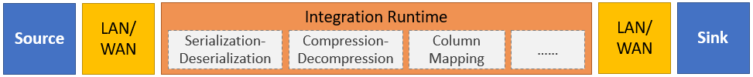
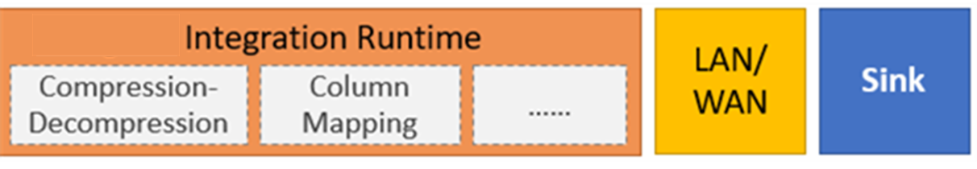
Copy files with the Copy Activity
Copy activity can compress
and decompress files with
The following codecs:
  Gzip
  Deflate
  Bzip2
  ZipDeflate
Supported file formats:
  Text
  JSON
  Avro
  ORC
  Parquet
Notes:
TALKING POINTS
The Copy Activity process, reads the data from the source, and is executed through the Integration runtime.
The runtime itself, performs a serialization/deserialization process, compression/decompression and the column mapping.
These steps are performed based on the input configuration of the source dataset, the output dataset, and execution configuration set on the copy activity.
To copy files, using the Copy Activity, ADF supports a set of supported file formats, which can also be compressed/decompressed using a variety of codecs.
PRESENTER NOTES AND GUIDANCE
The supported file formats are not a complete list, and only represent common formats. More information can be found at
This information is used to serve as a reminder of information you will need to know to present this slide
Refresh yourself with an overview of Azure Data Factory with the following link:
https://docs.microsoft.com/en-us/azure/data-factory/copy-activity-overview

Slide 9
Ingesting data with Azure Synapse Pipelines
Demo
Notes:
TALKING POINTS​
​
Let’s put this into reality and show you how it works.​
​
All instructions and context are found in this repository​
​
The demo instructions for this section can be found at: https://aka.ms/ctovtd41
​
The demo setup can be found at the following url: https://aka.ms/ctodesgdeployasyn​
​
​
​

Slide 10
Perform code-free transformation at scale with Azure Synapse Pipelines
Notes:
TALKING POINTS
Let’s have a closer look on how to perform data transformations with the ADF Mapping Data Flow

Slide 11
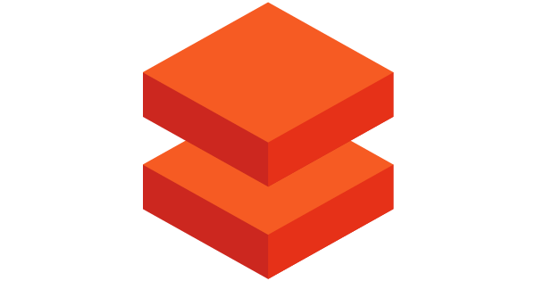

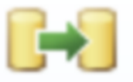
Methods for transforming in Azure Synapse Pipelines
Compute resources
SSIS Packages
Mapping Data Flow
Notes:
TALKING POINTS
Azure Data Factory has 3 methods to perform data transformations
PPRESENTER NOTE: this is a build slide
Execute a compute resource
You can use ADF to orchestrate the execution of transformation on a compute resources such as Azure Databricks, HDInsight or Azure SQL Server using the native language that the compute resources uses.
Execute existing SSIS package
You can leverage existing investments in your data transformations from SSIS packages that you have previously creates as the can be used by ADF
Use the Mapping Data Flow within ADF
You can perform transformation using the new Mapping Data Flow capability within Azure Data Factory
PRESENTER NOTES AND GUIDANCE
Refresh yourself with an overview of Azure Data Factory Mapping Data Flow with the following link:
https://docs.microsoft.com/en-us/azure/data-factory/transform-data
As an alternative, you can run this animation
https://channel9.msdn.com/Shows/Learn-Azure/ADF-Transformation-Methods

Slide 12
Methods for transforming in Azure Synapse Pipelines
Code free data transformation at scale
Compute resources
SSIS Packages
Mapping Data Flow
Notes:
TALKING POINTS
So let’s dive into the data flow mapping
Mapping data flows are visually designed data transformations in Azure Data Factory.
Data flows allow data engineers to develop graphical data transformation logic without writing code.
The resulting data flows are executed as activities within Azure Data Factory pipelines that use scaled-out Spark clusters.
Data flow activities can be operationalized via existing Data Factory scheduling, control, flow, and monitoring capabilities. Mapping data flows provide a fully visual experience with no coding required.
Your data flows will run on your own execution cluster for scaled-out data processing. Azure Data Factory handles all the code translation, path optimization, and execution of your data flow jobs.
Data Flow mapping brings the following benefits and capabilities:
- Perform data cleansing, transformation, aggregations, etc.
- Enables you to build resilient data flows in a code free environment
- Enable you to focus on building business logic and data transformation
Underlying infrastructure is provisioned automatically with cloud scale via Spark execution
Like many data transformation tools, Mapping Data Flow in Azure Data factory supports a great variety of data transformations.
In the demo we’ll have a closer look on how to map data transformations
Select transformation
Filter Transformation
Derive Transformation
Window Transformation
Aggregate Transformation
Alter Row Transformation
Adding a transformation is done by clicking on the + symbol
PRESENTER NOTES AND GUIDANCE
This information is used to serve as a reminder of information you will need to know to present this slide
Refresh yourself with an overview of Azure Data Factory Mapping Data Flow with the following link:
https://docs.microsoft.com/en-us/azure/data-factory/transform-data

Slide 13
Demo: Transforming your data with Azure Synapse Pipelines
Speaker name
Notes:
TALKING POINTS​
​
Let’s put this into reality and show you how it works.​
​
All instructions and context are found in this repository​
​
The demo instructions for this section can be found at: https://aka.ms/ctovtd42
​
The demo setup can be found at the following url: https://aka.ms/ctodesgdeployasyn​
​
​
​

Slide 14
Orchestrate data movement and transformations with Azure Synapse Pipelines

Slide 15
Orchestrating Azure Synapse Analytic Spark Notebooks with ADF
1.
Create Storage
Account
2.
Create Azure
Data Factory
3.
Create data
workflow
pipeline
4.
Add Azure Synapse
Analytics Spark
Notebook to
pipeline
5.
Perform analysis
on the data
Notes:
TALKING POINTS
The attendees should already be familiar with the first three steps of creating a storage account, creating Azure Data Factory, and creating a data workflow activity using a Copy Activity.
Focus on steps 4 and 5 which are focused in Azure Synapse Analytics Spark pools
PRESENTER NOTES AND GUIDANCE
There are a range of compute resources that can be orchestrated by ADF, we are just using Azure Databricks as an example.

Slide 16
Orchestrate data movement and transformations with Azure Synapse Pipelines
Demo
Notes:
TALKING POINTS​
​
Let’s put this into reality and show you how it works.​
​
All instructions and context are found in this repository​
​
The demo instructions for this section can be found at: https://aka.ms/ctovtd43
​
The demo setup can be found at the following url: https://aka.ms/ctodesgdeployasyn​

Slide 17
Resources
Session Resources Hub
aka.ms/apps10
Session Code on GitHub
aka.ms/apps10repo
All Event Session Resources
aka.ms/mymsignitethetour

Slide 18
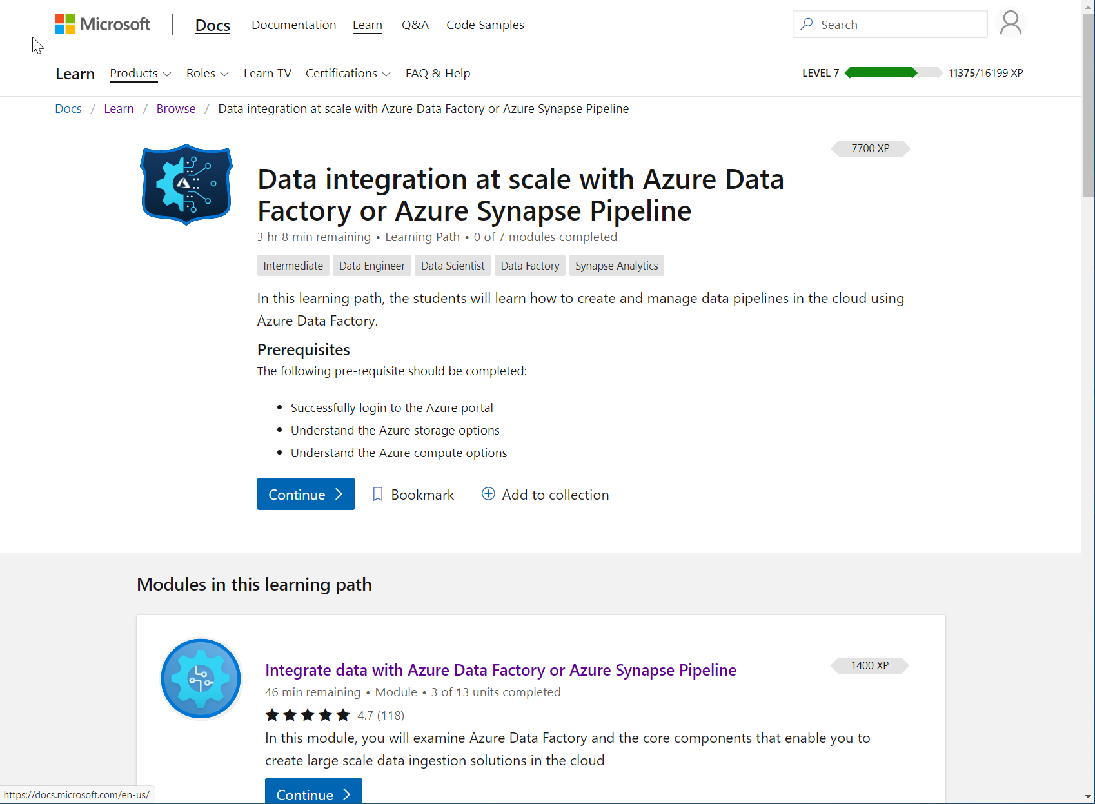
/learn alert
Complete interactive learning exercises, watch videos,
and practice and apply your new skills.
aka.ms/mslearnasapipelines

